Slide 1

Progressive GAN Deep Learning
Tali Amit Noor Abu Abeid
Eyal Romano Saher Saadi

Slide 2
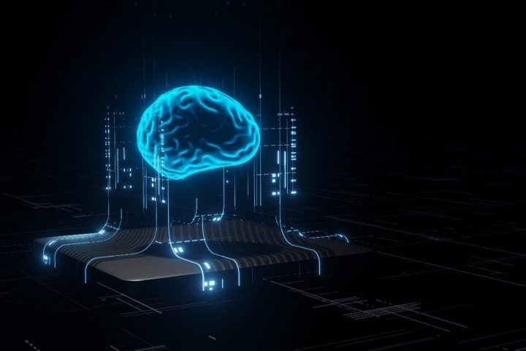
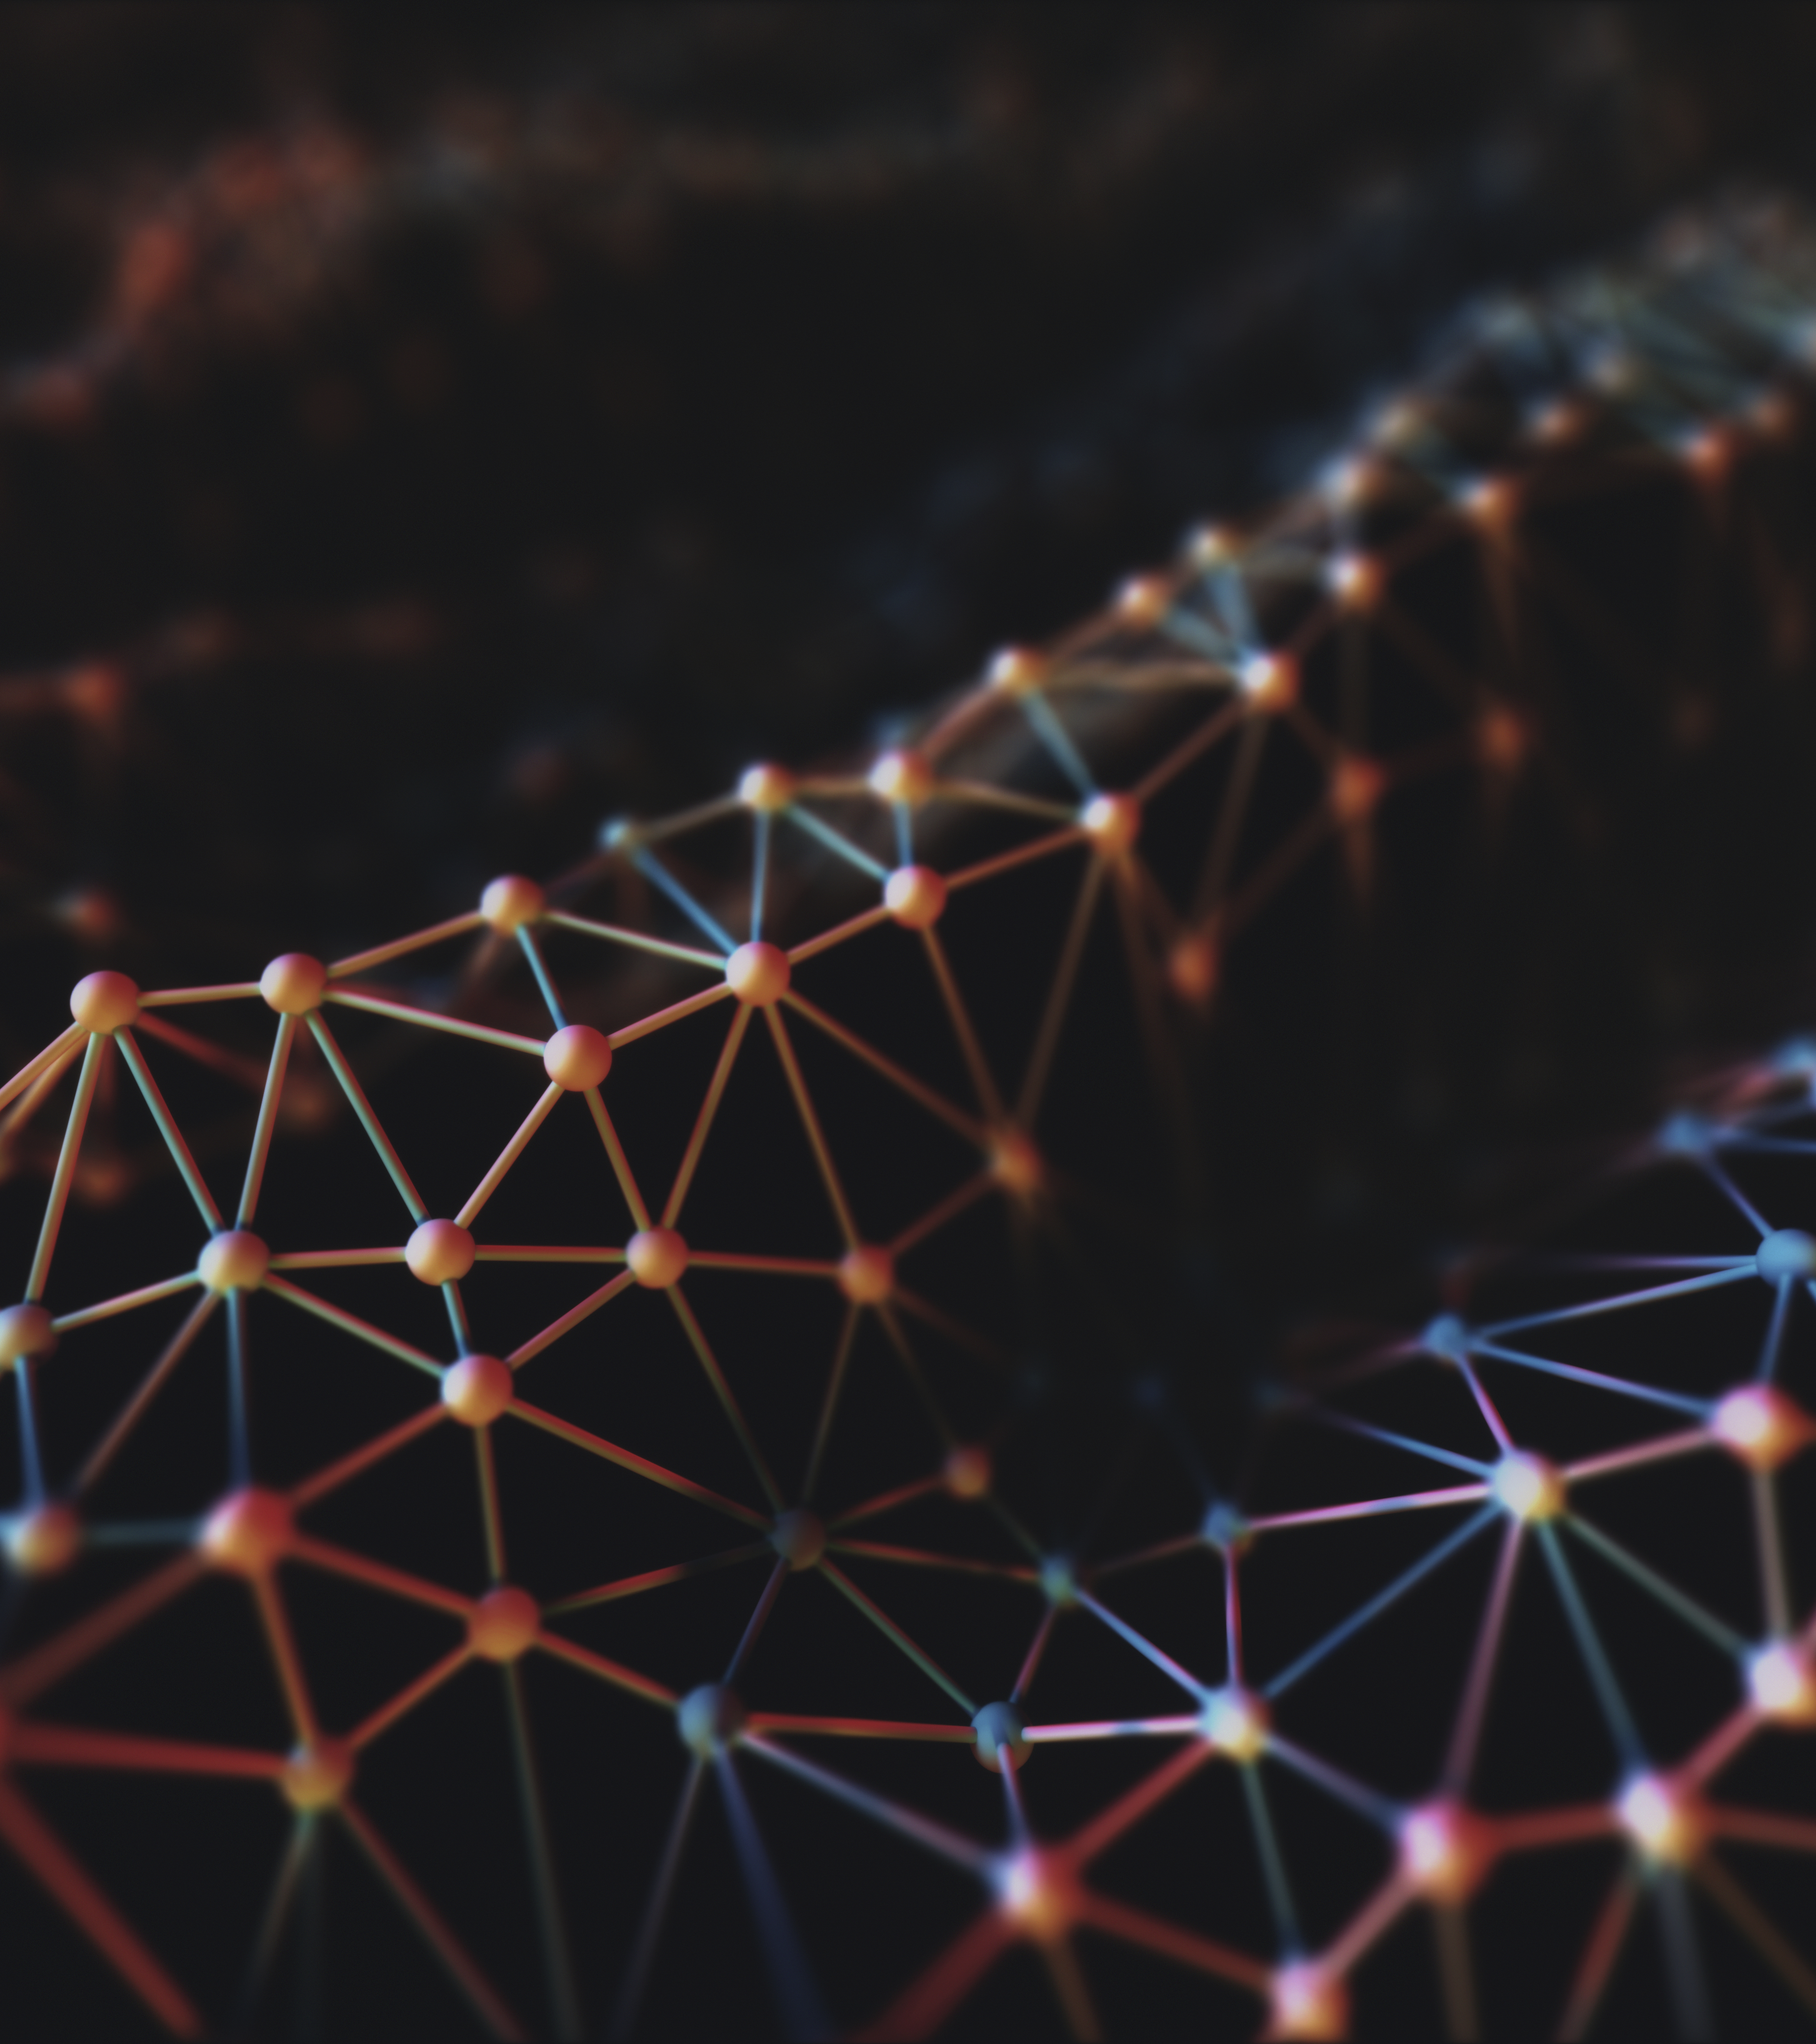
Table Of Contents
Introduction to GAN
Progressive GAN
Code Preparations
Data-set Preparations
PG GAN Layers

Slide 3

GAN - Generative Adversarial Network
GAN is a class of machine learning frameworks designed by Ian Goodfellow and his colleagues in June 2014. Given a training set, this technique learns to generate new data with the same statistics as the training set.
For example, a GAN trained on photographs can generate new photographs that look at least superficially authentic to human observers, having many realistic characteristics.

Slide 4
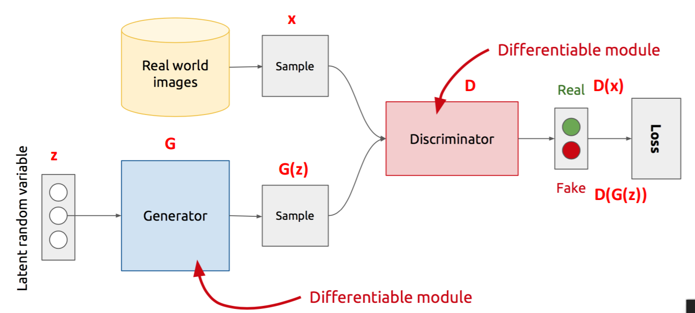
GAN Architecture

Slide 5
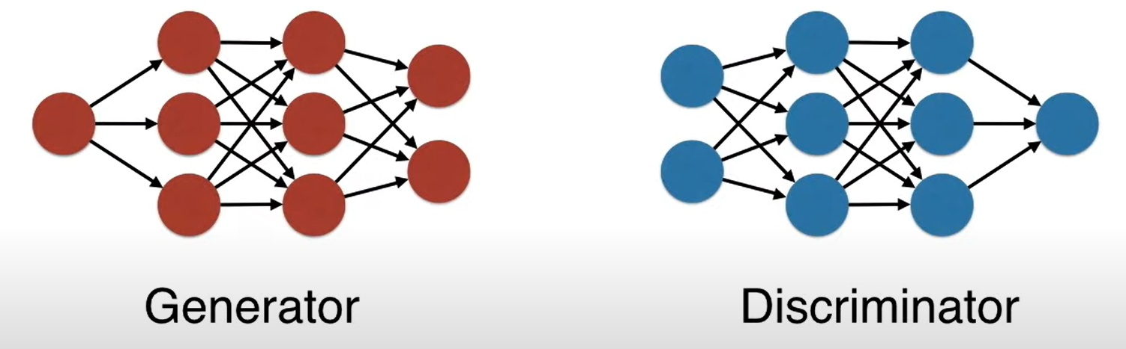
GAN Architecture

Slide 6

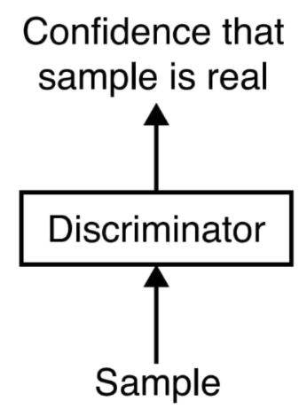
The Discriminator
The discriminator takes a sample as an input, and its output is a single value that reports the network’s confidence that the input is from the training set, rather than an attempted forgery

Slide 7
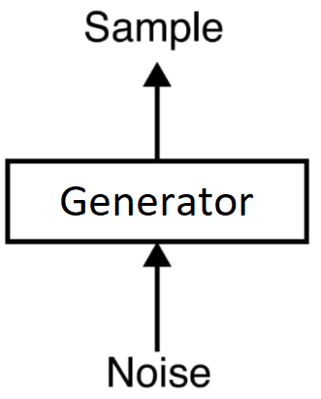

The Generator
The generator takes at first a bunch of random numbers as input. The output is a synthetic sample. An error function will help the generator to generate a better samples that are more alike the real training data

Slide 8
Major problems
Easily able to differentiate b/w real and fake if generated images are large.
High-quality images requires large GPU memory.
Less batch size will make an unstable GAN model.
Difficult to produce large and fine detailed images.

Slide 9
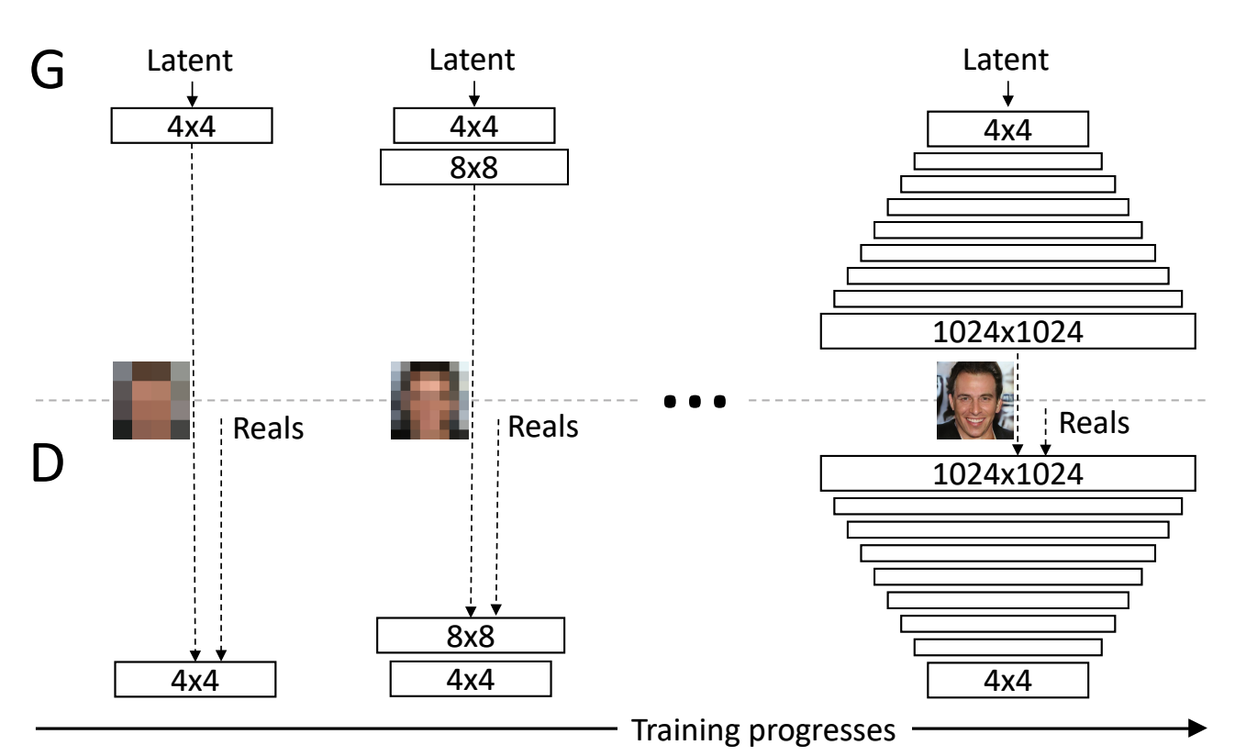
Progressive Growing GAN - overview
Progressive Growing GAN involves using a generator and discriminator model with the same general structure and starting with very small images. During training, new blocks of convolutional layers are systematically added to both the generator model and the discriminator models.

Slide 10
PGGAN - benefits
Training avoids the high-resolution problem of too much divergence early on.
Faster training.
More stable training - more steps done at lower resolution with larger minibatches.

Slide 11
Dataset Preparation
We are going to use the Large-scale Celebrity Faces Attribute Dataset, referred to as CelebA.
It contains 200,000 different pictures of celebrities

Slide 12
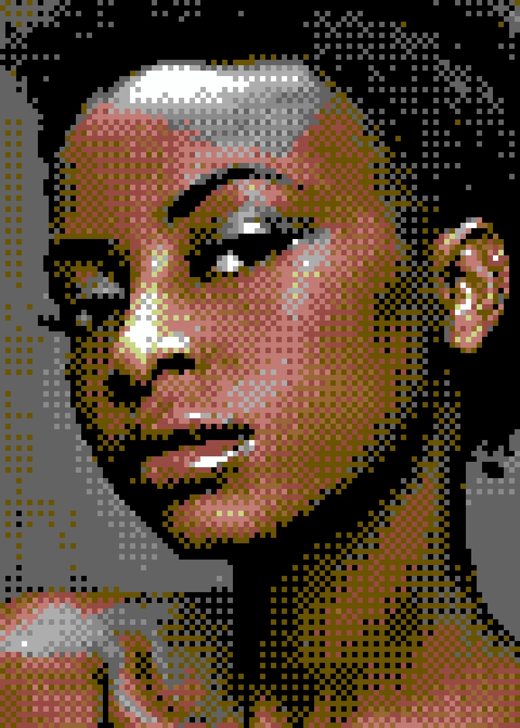
Dataset Preparation
For each picture in our dataset :
Load picture to our system
Detect a face
Extract face
Resize picture to a fix size

Slide 13
Detect A Face With MTCNN
MTCNN - Multi-Task Cascaded Convolutional Neural Networks
MTCNN is a neural network which detects faces and facial landmarks on images

Slide 14

Extract The Face From The Picture
width
height
(x1,y1)

Slide 15
Resize picture
We want all our pictures to be in the same fix size (for example, 128 x 128 pixels)
128
128

Slide 16
Dataset Preparation
After doing all the steps for all the pictures - we now have a new dataset that is ready for PG_GAN training \ testing.

Slide 17

PG GAN Layers
Progressive Growing & Smoothing in of Higher Resolution Layers
Minibatch standard deviation
Equalized Learning Rate
Pixel-wise Feature Normalization

Slide 18

Progressive Growing & Smoothing In Of Higher Resolution Layers
Used to control the weighted sum of the old and new layers during a growth phase
It uses a variable called alpha that controls how much to weight the first and second inputs
0 $≤$ α $≤$ 1
weighted sum = ((1.0 – α) * input1) + (α * input2)

Slide 19
Progressive Growing & Smoothing In Of Higher Resolution Layers

Slide 20
Progressive Growing & Smoothing In Of Higher Resolution Layers
When α is close to 0
When α is close to 1

Slide 21
Minibatch Standard Deviation
Karras created a way for the Discriminator to tell whether the samples it is getting are varied enough.
In essence, we calculate a single extra scalar statistic for the Discriminator. This statistic is the standard deviation of all the pixels in the mini-batch that are generated by the Generator or that come from the real data
MB_SD
MB_SD
MB_SD
MB_SD
DATA

Slide 22

Minibatch Standard Deviation
Now, all the Discriminator needs to learn is that if the standard deviation is low in the images from the batch it is evaluating, the image is likely fake, because the real data has more variance.
The Generator has no choice but to increase the variance of the generated samples to have a chance to fool the Discriminator.
Low MB_SD ~ Fake
High MB_SD ~ Real

Slide 23
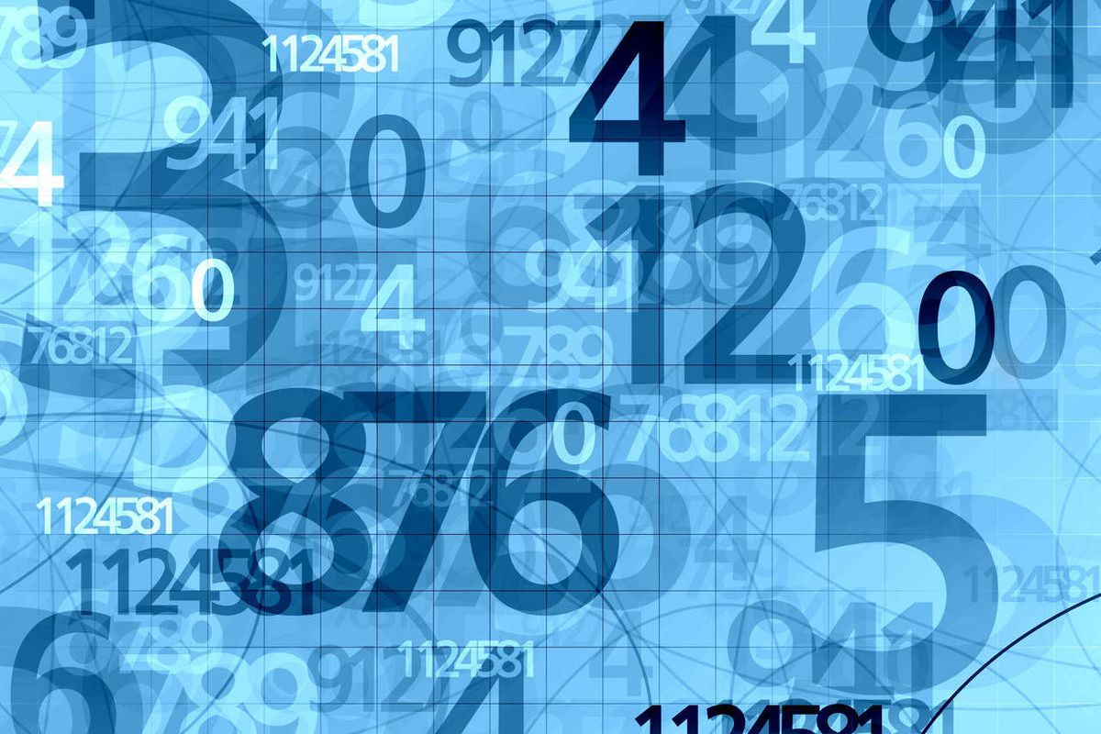
Equalized Learning Rate
The idea behind equalized learning rate is to scale the weights at each layer with a constant such that the updated weight w' is scaled to be w' = w /c, where c is a constant at each layer.
This is done during training to keep the weights in the network at a similar range.

Slide 24
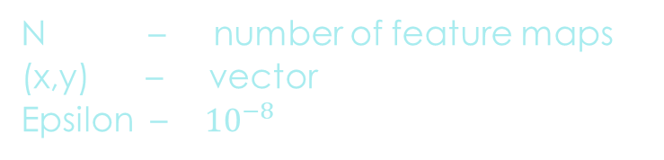
Pixel Normalization
Used to normalize activation maps in the generator model in order to unit the length which means that we used it when the training data and testing data does not come from the exact same distribution.
The equation:
N – number of feature maps (x,y) – vector Epsilon – ${10}^{−8}$

Slide 25

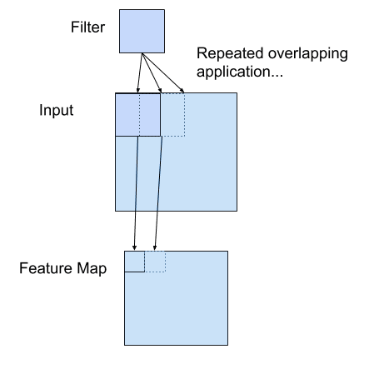
PGGAN based on CNN
Convolutional neural networks apply a filter to an input to create a feature map that summarizes the presence of detected features in the input.
Once a feature map is created, we can pass each value in the feature map through a nonlinearity function, such as a ReLU.

Slide 26
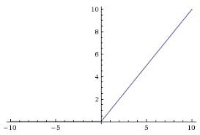
ReLU activation functions
The function returns 0 if it receives any negative input, but for any positive value x it returns that value back.

Slide 27
Code Preparation
Keras library.
Dataset : 200,000 images. We took 20,000 in this project.
Images with backgrounds.
Cut just the faces and put them into a file: “img_align_celeba_128.npz”
The new size of the image: 128X128
Plot the faces: 10 in line

Slide 28
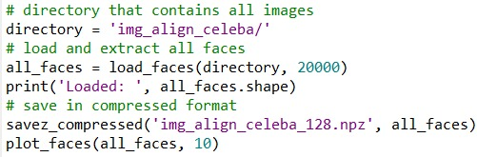
Code Preparation
The main code for preparation:

Slide 29
Code Preparation
The second file: Training.
Number of phases 6 : from 4X4 to 128X128.
Noise: 100
First, we defined the base model that accepts 4×4 images by define_discriminator function, the define_generator same process. We put them into single model by define_composite function.

Slide 30
Code Preparation
Train the generator and the discriminator in the images that exist in the file that we created.
Output : we got two files:
1. tuned: generated images.
2. fade: images after training.

Slide 31
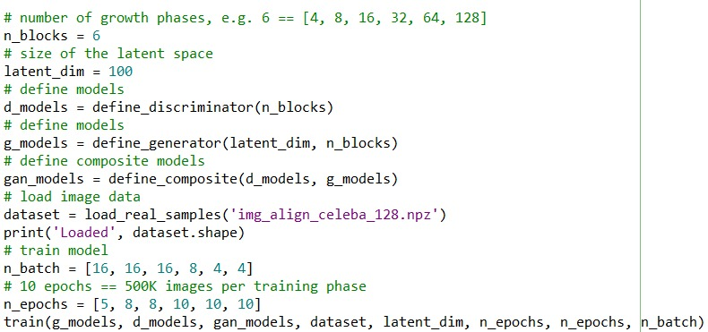
Code Preparation
The main code for second file:

Slide 32
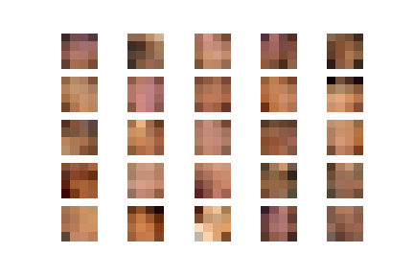
The Results:
4X4:
Tuned:

Slide 33
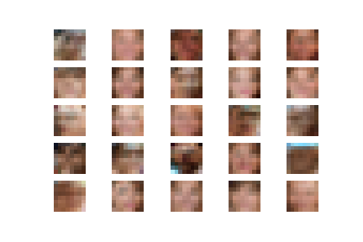
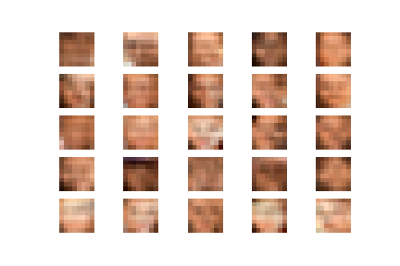
8X8:
Tuned:
Faded:

Slide 34
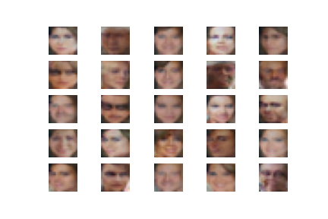
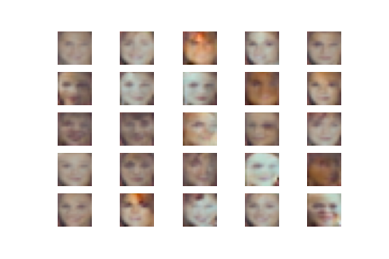
16X16:
Tuned:
Faded:

Slide 35
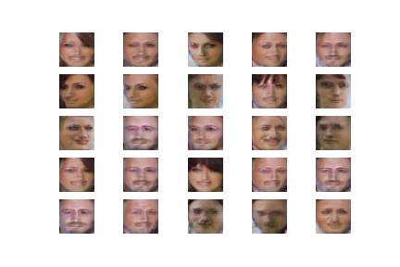
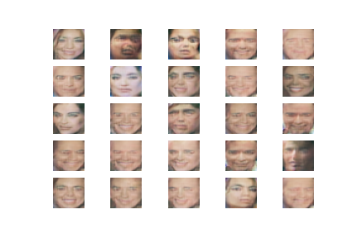
32X32:
Tuned:
Faded:

Slide 36
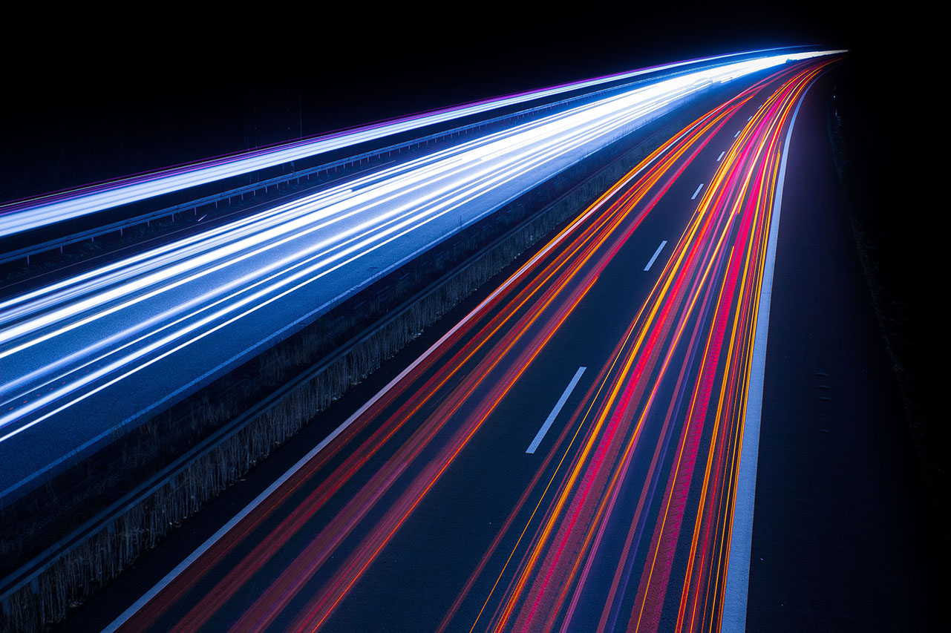
Thank You,
Group 22

